Slide 1

Practical Strategies for Treating and Managing Individuals with Elevated Psychopathy
Ernie Marshall, LCSW
Licensed Clinical Social Worker
WIATSA 2026
2:30 PM – 4:00 PM

Slide 2
SESSION 01 · OVERVIEW
Learning Objectives
01
Identify psychopathy traits
Core interpersonal, affective, lifestyle, and antisocial features.
02
Differentiate psychopathy, ASPD, and sociopathy
Clarify overlapping but distinct constructs.
03
Understand development
Genetic, neural, and environmental contributors across the lifespan.
04
Apply treatment and management strategies
Evidence-informed approaches for clinical and team settings.
Practical Strategies for Elevated Psychopathy · Ernie Marshall, LCSW
2 / 46 · Session Overview

Slide 3
Why It Matters
Psychopathy affects treatment engagement, risk management, relationships, and organizational functioning.
Treatment
Risk
Relationships
Organizations
Engagement, retention, and outcomes
Safety planning and harm reduction
Family, peer, and dyadic impact
Workplace and institutional functioning
Practical Strategies for Elevated Psychopathy · Ernie Marshall, LCSW
3 / 46 · Session Overview

Slide 4
AUDIENCE POLL
“What challenges have you experienced working with highly manipulative clients?”
Share a brief example with a neighbor · 3 minutes
4 / 46 · Audience Poll

Slide 5

FOUNDATIONS · DEFINITION
What Is Psychopathy?
A pattern of interpersonal, affective, behavioral, and antisocial traits.
Interpersonal
Charm, grandiosity, deceit
Affective
Shallow emotion, lack of remorse
Behavioral
Impulsivity, irresponsibility
Antisocial
Rule violation, aggression
Practical Strategies for Elevated Psychopathy · Ernie Marshall, LCSW
5 / 46 · Foundations

Slide 6

FOUNDATIONS · HISTORICAL ROOTS
Cleckley's Contribution
“The Mask of Sanity” and the foundation of modern psychopathy research.
Hervey M. Cleckley, 1941
Practical Strategies for Elevated Psychopathy · Ernie Marshall, LCSW
6 / 46 · Foundations

Slide 7
FOUNDATIONS · MODELS
Hare's Model
Psychopathy as a measurable construct with interpersonal, affective, lifestyle, and antisocial domains.
01
02
03
04
Interpersonal
Affective
Lifestyle
Antisocial
Domain
Domain
Domain
Domain
Practical Strategies for Elevated Psychopathy · Ernie Marshall, LCSW
7 / 46 · Foundations

Slide 8
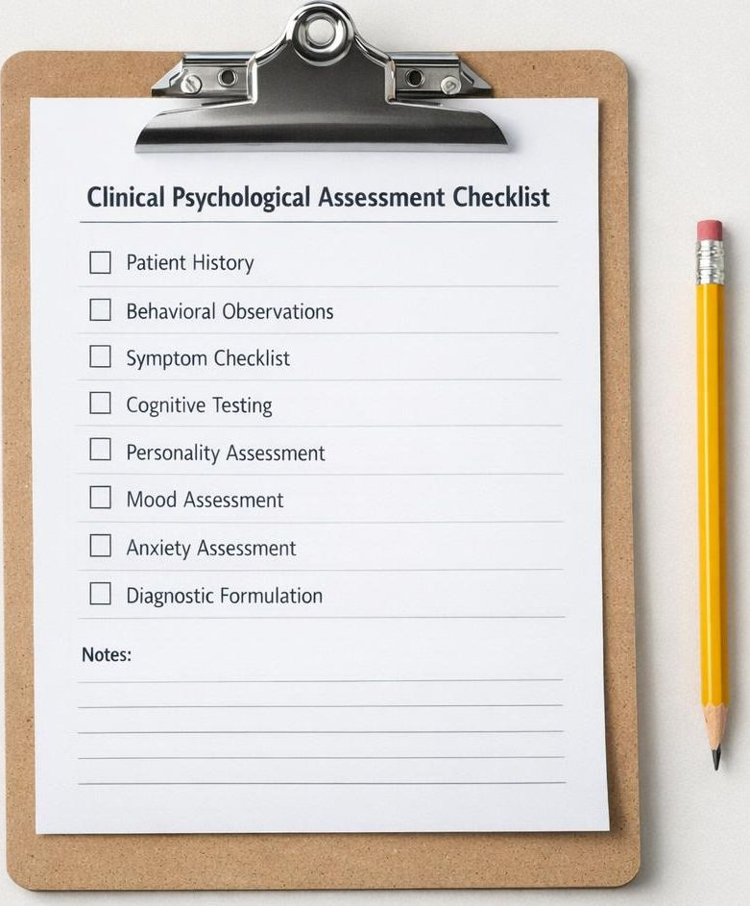
ASSESSMENT · INSTRUMENT
PCL-R
20-item clinician-rated assessment developed by Robert Hare.
20
0–40
≥30
Items
Score range
Common cutoff
Practical Strategies for Elevated Psychopathy · Ernie Marshall, LCSW
15 / 46 · Assessment

Slide 9
PCL-R · FACTOR 1
Factor 1
Interpersonal and affective deficits.
Superficial, glib charm
Grandiose self-worth
Pathological lying and conning
Lack of remorse, callousness, shallow affect
Practical Strategies for Elevated Psychopathy · Ernie Marshall, LCSW
16 / 46 · Assessment

Slide 10
PCL-R · FACTOR 2
Factor 2
Lifestyle instability and antisocial behavior.
Impulsivity and need for stimulation
Parasitic lifestyle, poor behavioral controls
Early behavior problems, juvenile delinquency
Criminal versatility, revocation
Practical Strategies for Elevated Psychopathy · Ernie Marshall, LCSW
17 / 46 · Assessment

Slide 11
CORE TRAITS · INTERPERSONAL
Core Interpersonal Traits
How individuals high in psychopathy present in social interactions.
Superficial charm
Grandiosity
Pathological lying
Manipulation
Practical Strategies for Elevated Psychopathy · Ernie Marshall, LCSW
8 / 46 · Core Traits

Slide 12
CORE TRAITS · AFFECTIVE
Core Affective Traits
Emotional features that shape clinical presentation.
Lack of remorse
Shallow affect
Callousness
Limited emotional depth
Practical Strategies for Elevated Psychopathy · Ernie Marshall, LCSW
9 / 46 · Core Traits

Slide 13
CORE TRAITS · LIFESTYLE
Lifestyle Traits
Behavioral patterns observable across daily functioning.
Impulsivity
Need for stimulation
Irresponsibility
Practical Strategies for Elevated Psychopathy · Ernie Marshall, LCSW
10 / 46 · Core Traits

Slide 14
CORE TRAITS · ANTISOCIAL
Antisocial Features
Behavioral markers often visible in records and history.
Rule violations
Aggression
Criminal versatility
Practical Strategies for Elevated Psychopathy · Ernie Marshall, LCSW
11 / 46 · Core Traits

Slide 15
DIFFERENTIATION
Psychopathy vs ASPD
Most people with psychopathy meet ASPD criteria; many with ASPD do not meet psychopathy criteria.
Psychopathy
ASPD
Overlap
Narrower construct · affective + interpersonal core
Broader DSM diagnosis · behaviorally defined
Practical Strategies for Elevated Psychopathy · Ernie Marshall, LCSW
12 / 46 · Differentiation

Slide 16
DIFFERENTIATION
Psychopathy vs Sociopathy
Sociopathy is not a formal diagnosis and is inconsistently defined.
Psychopathy
Sociopathy
Empirically measured construct (e.g., PCL-R). Strong research base.
Colloquial term. No formal diagnostic criteria. Use cautiously.
Practical Strategies for Elevated Psychopathy · Ernie Marshall, LCSW
13 / 46 · Differentiation

Slide 17
ALTERNATIVE MODELS
Triarchic Model
Boldness, meanness, and disinhibition.
Boldness
Meanness
Disinhibition
Fearless dominance, social poise, stress immunity
Callous aggression, exploitativeness
Impulsivity, poor regulation, irresponsibility
Practical Strategies for Elevated Psychopathy · Ernie Marshall, LCSW
18 / 46 · Models

Slide 18
EPIDEMIOLOGY
Prevalence
Approximately 1% in the general population; significantly higher in forensic settings.
~1%
15–25%
Higher
General population
Incarcerated populations
Forensic & high-risk settings
Practical Strategies for Elevated Psychopathy · Ernie Marshall, LCSW
19 / 46 · Epidemiology

Slide 19
DEVELOPMENT · ETIOLOGY
Genetic Contributions
Temperament and heritability contribute to risk.
Heritability
Twin and adoption studies indicate substantial genetic loading
Temperament
Early traits — fearlessness, low harm avoidance — show continuity
Gene × environment
Risk emerges through interaction with environmental factors
Practical Strategies for Elevated Psychopathy · Ernie Marshall, LCSW
20 / 46 · Development

Slide 20

NEUROBIOLOGY
Brain Differences
Amygdala
Reduced reactivity to distress and fear cues
Ventromedial PFC
Altered moral and emotional decision-making
Reward processing
Atypical sensitivity to reward and punishment
Practical Strategies for Elevated Psychopathy · Ernie Marshall, LCSW
21 / 46 · Development

Slide 21
NEUROBIOLOGY
Fear Processing
Reduced sensitivity to punishment and distress cues.
Clinical implication
Standard contingencies that rely on fear of consequence may be insufficient. Plan for behavioral structure and immediate, predictable feedback.
Practical Strategies for Elevated Psychopathy · Ernie Marshall, LCSW
22 / 46 · Development

Slide 22

DEVELOPMENT · ENVIRONMENT
Environmental Factors
Parenting, trauma, peer influences, and social learning.
Parenting practices
Trauma exposure
Peer influences
Social learning
Practical Strategies for Elevated Psychopathy · Ernie Marshall, LCSW
23 / 46 · Development

Slide 23
YOUTH PRECURSORS
Callous-Unemotional Traits
Potential developmental precursors in youth.
Limited empathy
Lack of guilt
Reduced concern for others' feelings
Minimal remorse after harm
Shallow affect
Indifference to performance
Restricted emotional expression
Low concern for outcomes in school or activities
Practical Strategies for Elevated Psychopathy · Ernie Marshall, LCSW
24 / 46 · Development

Slide 24
CLINICAL PICTURE
Empathy
Cognitive empathy may remain intact while affective empathy is diminished.
Cognitive empathy
Affective empathy
OFTEN INTACT
OFTEN DIMINISHED
Can read and predict others' mental states.
Limited resonance with others' emotional experience.
Practical Strategies for Elevated Psychopathy · Ernie Marshall, LCSW
25 / 46 · Clinical Picture

Slide 25
CLINICAL PICTURE
Relationships
Manipulation, exploitation, and unstable attachments.
Manipulation
Exploitation
Unstable attachments
Limited reciprocity
Practical Strategies for Elevated Psychopathy · Ernie Marshall, LCSW
26 / 46 · Clinical Picture

Slide 26

TREATMENT · ENGAGEMENT
Clinical Presentation
Why these clients often enter treatment.
Court-mandated
Family pressure
Workplace consequence
Crisis or instrumental gain
Practical Strategies for Elevated Psychopathy · Ernie Marshall, LCSW
28 / 46 · Treatment

Slide 27
TREATMENT CHALLENGE · 01 OF 04
Treatment Challenge: Motivation
Limited internal motivation for change.
Clinical implication
Expect engagement driven by external pressures. Anchor goals to concrete, self-relevant outcomes the client values, and revisit them often.
Practical Strategies for Elevated Psychopathy · Ernie Marshall, LCSW
29 / 46 · Treatment Challenges

Slide 28
TREATMENT CHALLENGE · 02 OF 04
Treatment Challenge: Manipulation
Managing deception and impression management.
Clinical implication
Verify report against collateral data. Don't personalize manipulation — name it, document it, and return to behavioral evidence.
Practical Strategies for Elevated Psychopathy · Ernie Marshall, LCSW
30 / 46 · Treatment Challenges

Slide 29
TREATMENT CHALLENGE · 03 OF 04
Treatment Challenge: Splitting
Maintaining team consistency.
Clinical implication
Communicate proactively across providers. Use shared documentation and aligned messaging. Never adjudicate provider disagreements in front of the client.
Practical Strategies for Elevated Psychopathy · Ernie Marshall, LCSW
31 / 46 · Treatment Challenges

Slide 30
TREATMENT CHALLENGE · 04 OF 04
Treatment Challenge: Boundary Testing
Expect repeated attempts to test limits.
Clinical implication
Treat boundary testing as data, not provocation. Hold limits with consistency, calm tone, and pre-established consequences.
Practical Strategies for Elevated Psychopathy · Ernie Marshall, LCSW
32 / 46 · Treatment Challenges

Slide 31
MYTH BUSTER
Psychopathy does not automatically mean untreatable.
Treatment goals shift toward risk reduction, behavioral stability, and harm minimization — not personality transformation.
33 / 46 · Treatment Myth

Slide 32
EVIDENCE-BASED PERSPECTIVE
Evidence-Based Perspective
Focus on risk reduction and behavioral outcomes.
Measurable behavior
Harm reduction
Realistic targets
Track frequency, severity, and context of target behaviors.
Prioritize safety, stability, and reduced offending.
Aim for management and risk control, not personality change.
Practical Strategies for Elevated Psychopathy · Ernie Marshall, LCSW
34 / 46 · Treatment

Slide 33

STRATEGY 01 OF 05
Strategy 1: Structure
Clear expectations and predictable consequences.
Define rules in writing
Reinforce immediately
Repeat across settings
Practical Strategies for Elevated Psychopathy · Ernie Marshall, LCSW
35 / 46 · Strategies

Slide 34
STRATEGY 02 OF 05
02
Strategy 2: Boundaries
Firm, consistent, and transparent limits.
State limits clearly and in writing
Hold them with calm, predictable response
Avoid private exceptions or side deals
Practical Strategies for Elevated Psychopathy · Ernie Marshall, LCSW
36 / 46 · Strategies

Slide 35
STRATEGY 03 OF 05
03
Strategy 3: Behavioral Focus
Target observable behaviors rather than emotional insight.
Operationalize the behavior
Track frequency and context
Reward incremental change
Practical Strategies for Elevated Psychopathy · Ernie Marshall, LCSW
37 / 46 · Strategies

Slide 36
STRATEGY 04 OF 05
04
Strategy 4: Accountability
Use measurable goals and objective monitoring.
Set specific, time-bound targets
Use collateral verification
Document outcomes consistently
Practical Strategies for Elevated Psychopathy · Ernie Marshall, LCSW
38 / 46 · Strategies

Slide 37
STRATEGY 05 OF 05
05
Strategy 5: Team Coordination
Maintain communication across providers.
Hold regular case conferences
Use shared documentation
Align on messaging and limits
Practical Strategies for Elevated Psychopathy · Ernie Marshall, LCSW
39 / 46 · Strategies

Slide 38
CLINICIAN SELF-CARE
Countertransference
Recognize anger, fascination, rescue fantasies, and intimidation.
Anger
Fascination
Rescue fantasies
Intimidation
Practical Strategies for Elevated Psychopathy · Ernie Marshall, LCSW
40 / 46 · Clinician Self-Care

Slide 39
RISK MANAGEMENT
Risk Management
Documentation, consultation, and safety planning.
Documentation
Consultation
Practical Strategies for Elevated Psychopathy · Ernie Marshall, LCSW
41 / 46 · Risk

Slide 40

APPLICATION · INTERACTIVE
Case Vignette (if we have time)
Interactive discussion: assessment and intervention planning.
Step 01
What are the most clinically relevant traits?
Step 02
Which risks should we prioritize?
Step 03
What intervention plan would you propose?
Practical Strategies for Elevated Psychopathy · Ernie Marshall, LCSW
42 / 46 · Application

Slide 41
ETHICS
Ethical Considerations
Avoid stigma while remaining realistic about risk.
Avoid labeling
Diagnosis is not destiny. Choose language that informs care without stigmatizing the person.
Stay realistic
Acknowledge risk transparently. Document clinical reasoning.
Protect dignity
Apply standard ethical and informed-consent practices.
Practical Strategies for Elevated Psychopathy · Ernie Marshall, LCSW
43 / 46 · Ethics

Slide 42

CLOSE · KEY TAKEAWAYS
Key Takeaways
Structure
Predictable framework reduces volatility.
Consistency
Aligned team, aligned message.
Accountability
Measure behavior, not narrative.
Realistic goals
Risk reduction over personality change.
Practical Strategies for Elevated Psychopathy · Ernie Marshall, LCSW
44 / 46 · Close

Slide 43

DISCUSSION
Discussion & Questions
Clinical application and reflection.
45 / 46 · Close

Slide 44
CLOSE · REFERENCES
References
01
Cleckley, H. (1941). The Mask of Sanity.
02
Hare, R. D. (2003). Manual for the Hare Psychopathy Checklist–Revised (PCL-R), 2nd ed.
03
Patrick, C. J. (Ed.). (2018). Handbook of Psychopathy, 2nd ed.
04
Blair, R. J. R. (2013). Psychopathy: cognitive and neural dysfunction. Dialogues in Clinical Neuroscience.
05
Skeem, J. L., Polaschek, D. L. L., Patrick, C. J., & Lilienfeld, S. O. (2011). Psychopathic personality.
Practical Strategies for Elevated Psychopathy · Ernie Marshall, LCSW
46 / 46 · Close

